Slide 1
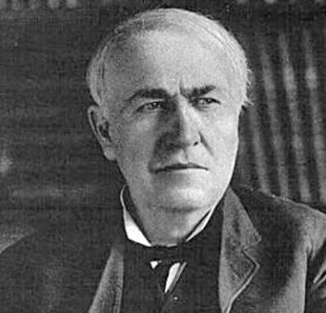
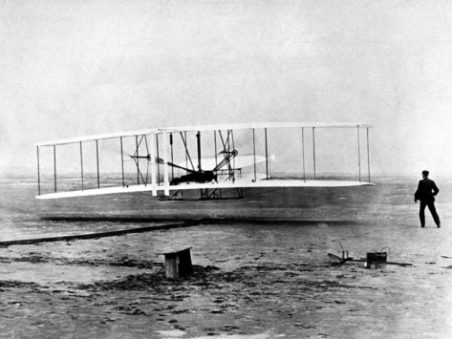

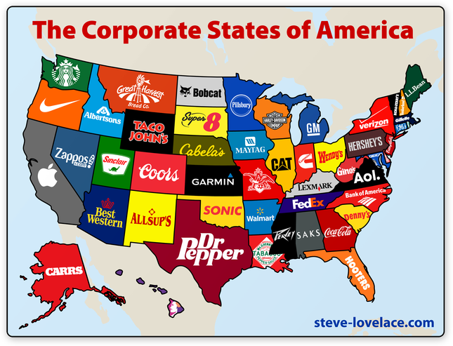
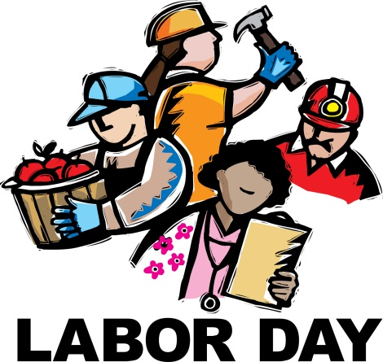
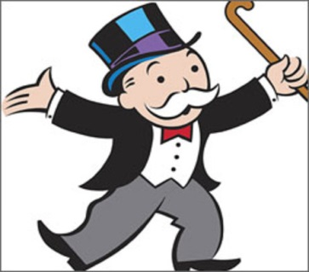
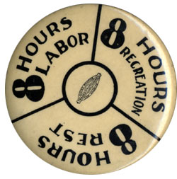
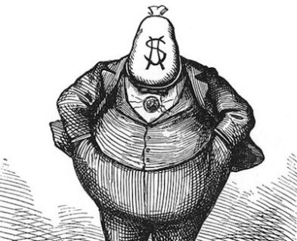
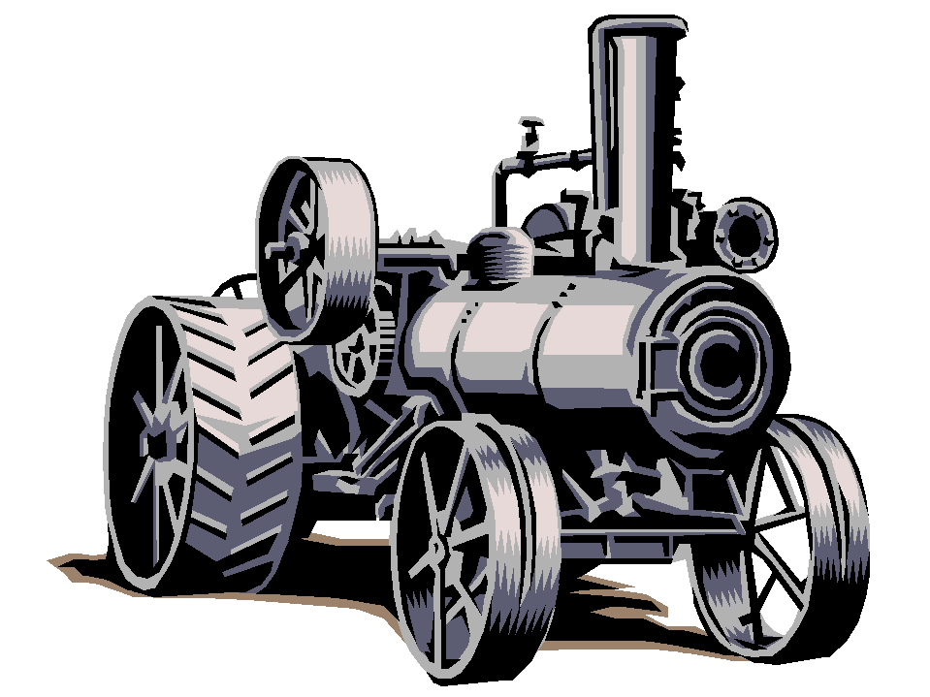
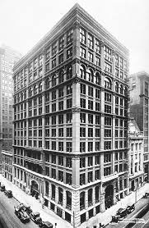
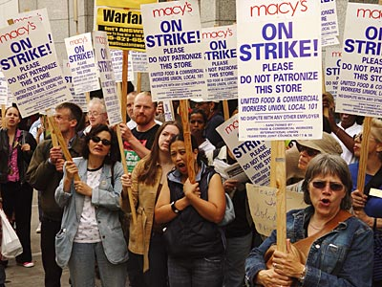
Industrialization
and the
“Gilded Age”
STAAR Review 2

Slide 2
Industrialization continued at a rapid pace in the years following the Civil War.
The Bessemer Process for making steel, allowed for a boom in industry.
New inventions – like the telegraph, telephone, typewriter, and the sewing machine made America more productive.
Natural Resources – like oil and electricity became important sources of energy.
Entrepreneurs – like John D. Rockefeller and Andrew Carnegie establish new business techniques.
Labor – workers would organize to gain higher wages, better working conditions, and an 8 hour workday.

Slide 3
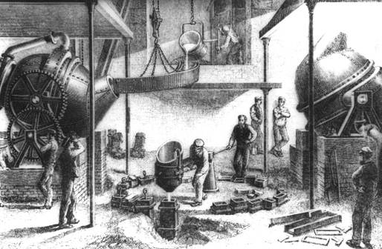
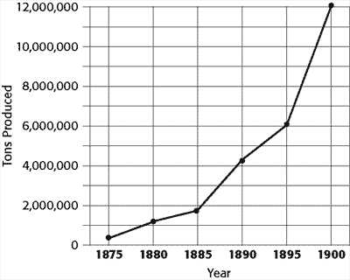
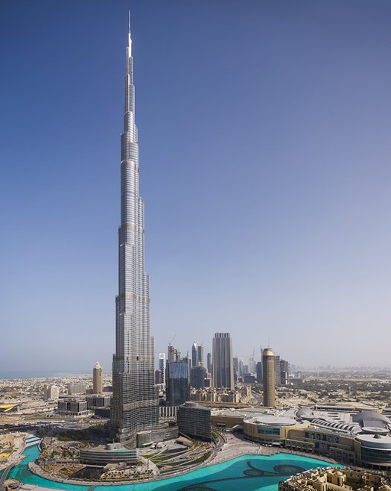
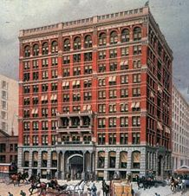
Technological Innovations
Bessemer Process – increased the amount and the quality of steel being produced.
This new steel was used to lay more miles of railroad track, to build the world’s 1st skyscrapers, and to make better machinery.
World’s 1st built in 1885 it was 180 feet tall
World’s tallest built in 2010 it is 2,722 feet

Slide 4
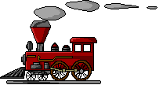
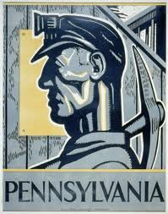
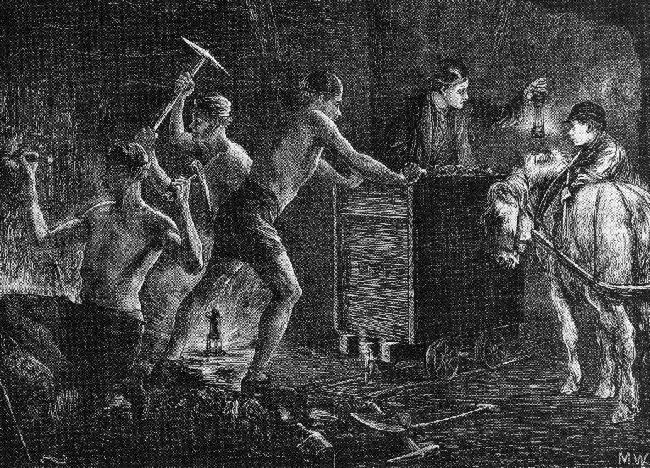
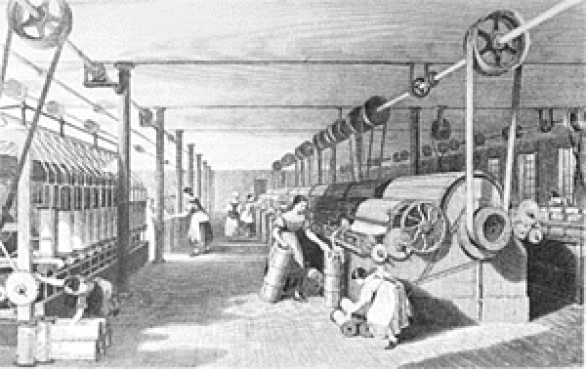
Technological Innovations
After the Civil War, human and animal strength were replaced by steam and electricity.
Steam engines, powered by burning coal to heat water, drove the textile mills, factories, and trains.
During the late 1800s the center of coal mining was in the Appalachian Mountains of western Pennsylvania.

Slide 5
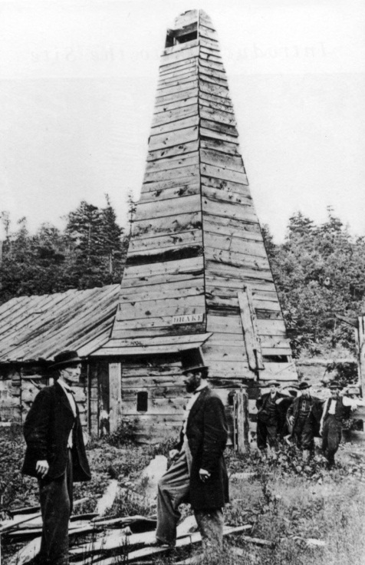
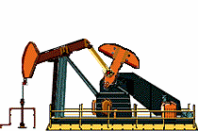
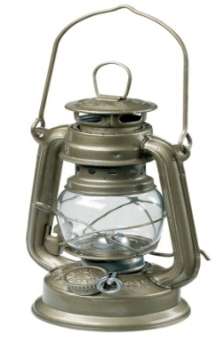
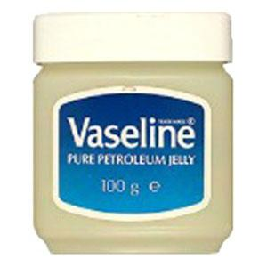
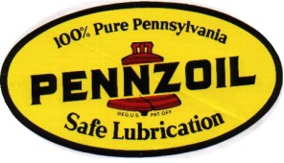
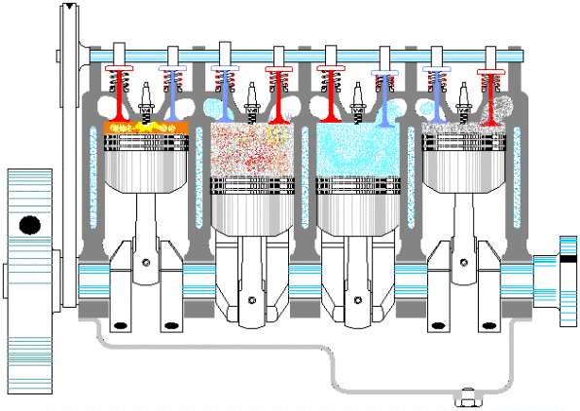

Technological Innovations
America’s first oil well was drilled in Titusville, Pennsylvania in 1859.
At first, oil was just used as a lubricant, later it was refined into kerosene for lighting.
It wasn’t until the internal combustion engine and the development of the car, that the demand for oil skyrocketed.
New sources of energy and transportation technologies have improved our mobility and our production capabilities.

Slide 6
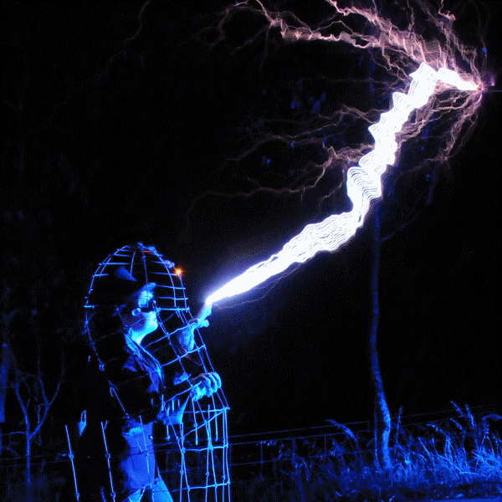

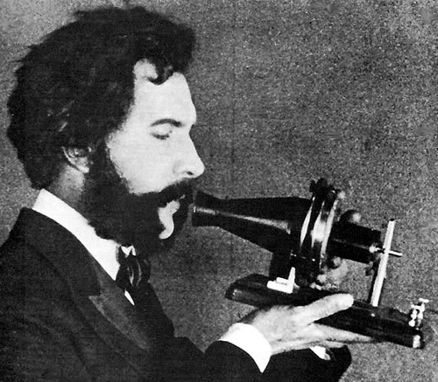

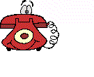
Electricity
Electricity
The use of electricity was another of the era’s most significant developments.
Electricity was first used as a means of communication with the telegraph.
The telegraph dramatically changed the speed at which we communicated over great distances and made the Pony Express obsolete.
Alexander Graham Bell would later perfect the telephone in 1876, it hasn’t stopped ringing since then.
Later communication improvements, like the IPhone would also make land line telephones obsolete.
Communications have never been the same!

Slide 7
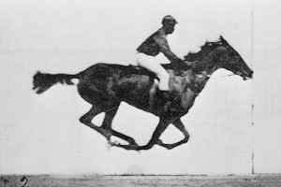
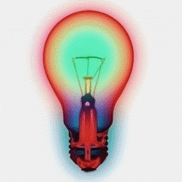
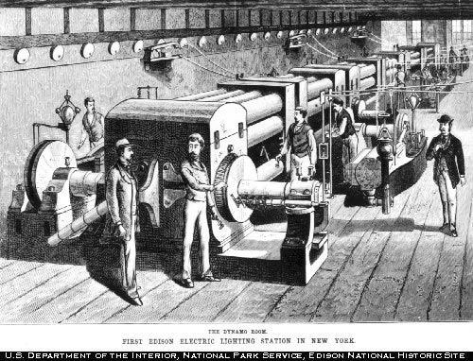
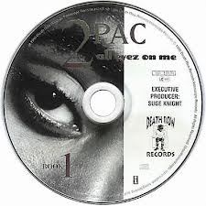

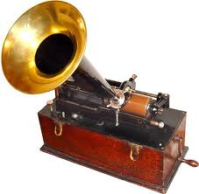
Technological Innovations
Thomas Edison would also use electricity to produce amazing results.
Edison designed a way to get electricity into homes and businesses, having electric appliances isn’t much good if you don’t have electricity.
Edison was able to create:
  Motion pictures, (entertainment)
  The light bulb, (world went 24/7)
  The phonograph, (which later gave way to other forms of recordings)

Slide 8
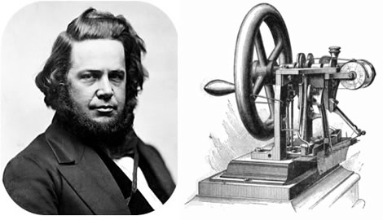

Other Inventors & Innovations
This was a time period of many inventions that improved the lifestyle and standard of living of many Americans.
Elias Howe – sewing machine, clothing could be made cheaper, faster, and now at home. (1846)
Elisha Otis – passenger elevators, the new technique of making steel allowed for skyscrapers, this created a need for elevators to carry people between floors. (1852)

Slide 9
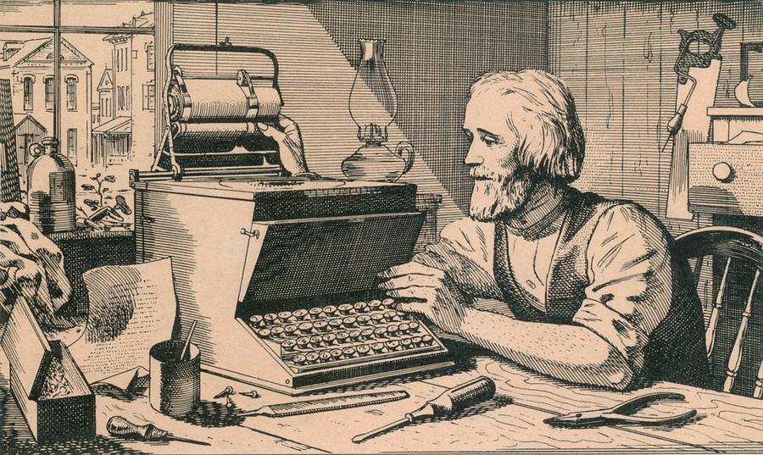

Other Inventors & Innovations
This was a time period of many inventions that improved the lifestyle and standard of living of many Americans.
Christopher Sholes – typewriter, made businesses more productive and helped improve communications. Eventually led to computer keyboards. (1867)
Wright Brothers – Orville & Wilbur first successful manned flight. Although their first flight lasted only seconds, it opened way for air travel at a dramatically increased speed and distance travelled. (1903)

Slide 10
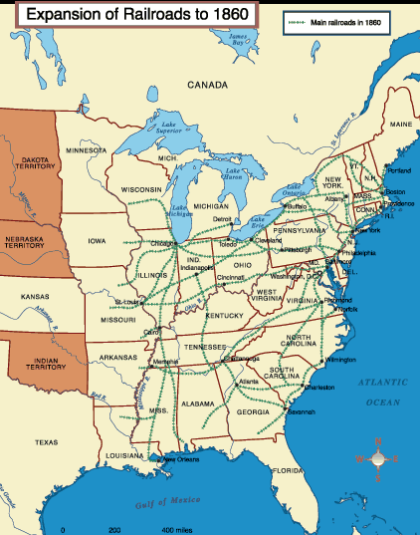
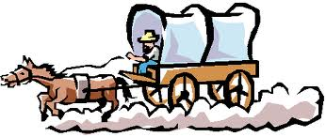
The Growth of Railroads
Before the Civil War, most of the railroad track in America had been built in the Eastern USA, especially in the Northeast.
Gold was discovered in the West and people slowly began migrating westward.
Travel was slow and difficult.
There was a desire to build a transcontinental railway that connected the East coast with the riches of California and the West.
But what route would it take?

Slide 11
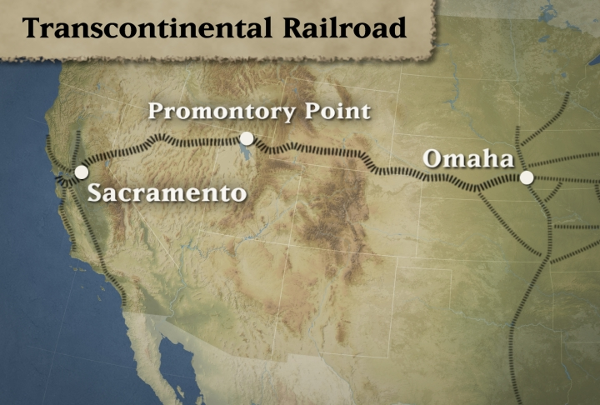
The Transcontinental Railroad
Railroads would have a significant impact on the economic, cultural, and social development of the Western United States
Opinions differed as to which route to take.
Should it go through the North or along a southern route?
The resulting Civil War caused the Transcontinental Railroad to be built along a northern route from Omaha, Nebraska to Sacramento, California.
Travel time would decrease from months to a few days.

Slide 12
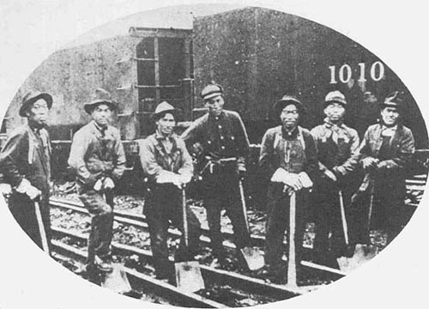
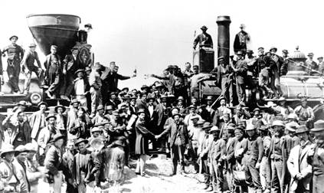
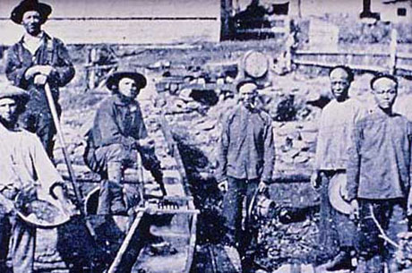
Building the Transcontinental Railroad
Civil War vets, Irish laborers, and free blacks started working westward from Omaha.
Chinese workers started eastward from Sacramento.
They met at Promontory Point, Utah.

Slide 13
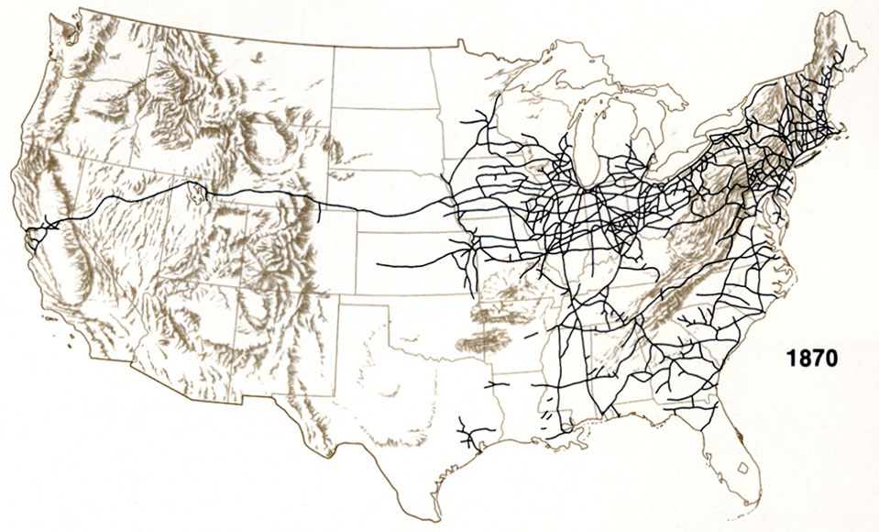
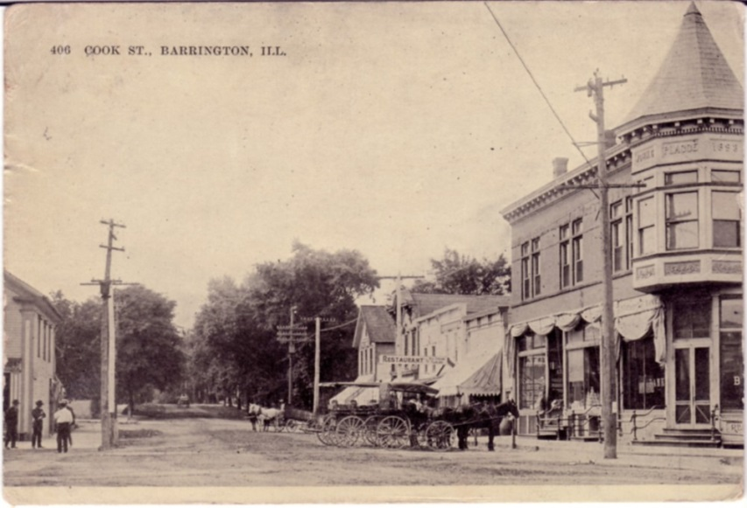
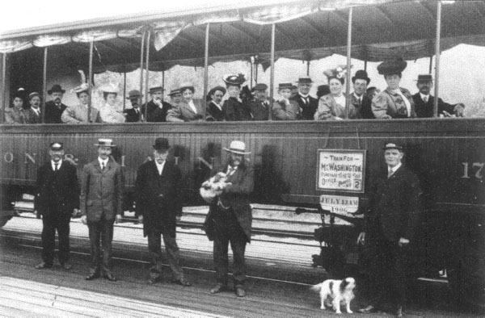
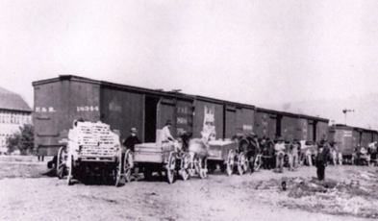
The Impact of the Railroads
The Transcontinental Railroad connected the different regions of the United States and Railroads became the lifeline to the West.
Trains brought the settlers and everything they needed to the West as towns sprang up.
Trains returned to the East with the products the West produced, beef, wheat, lumber, and gold.

Slide 14
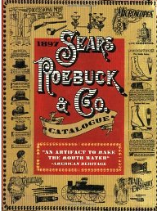
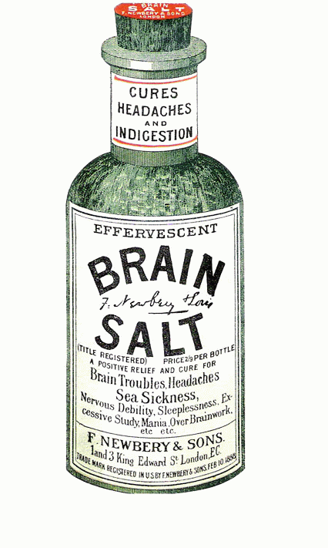

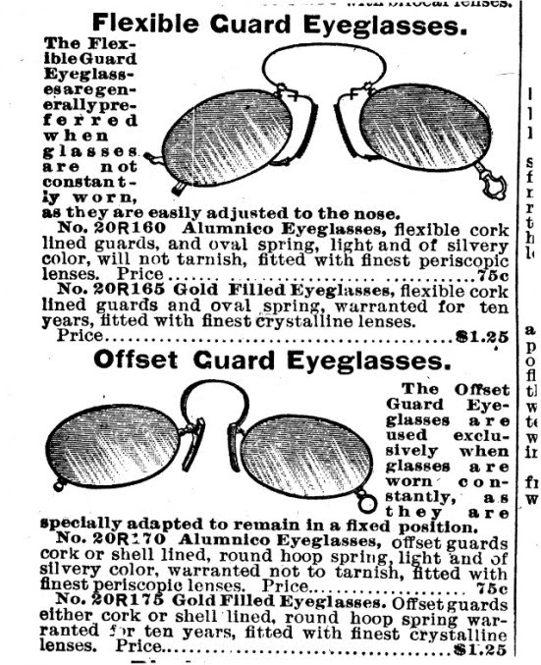
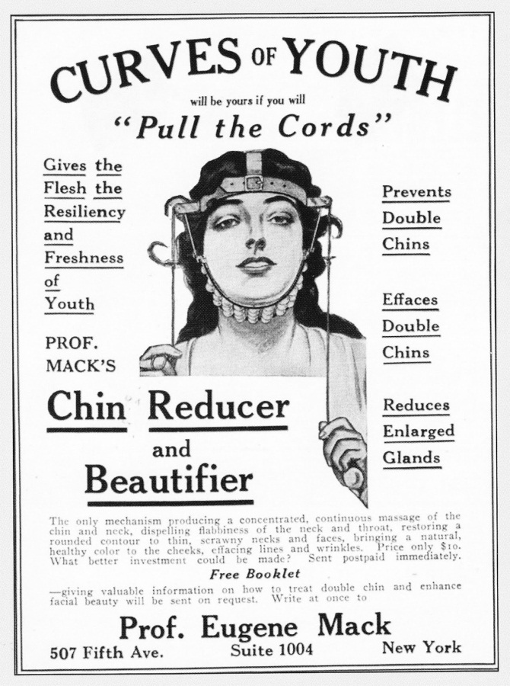
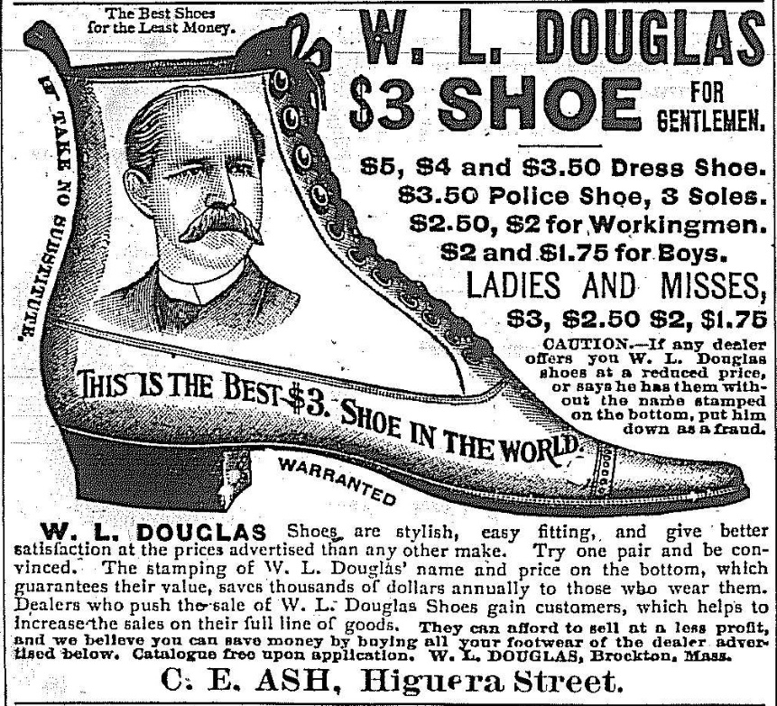
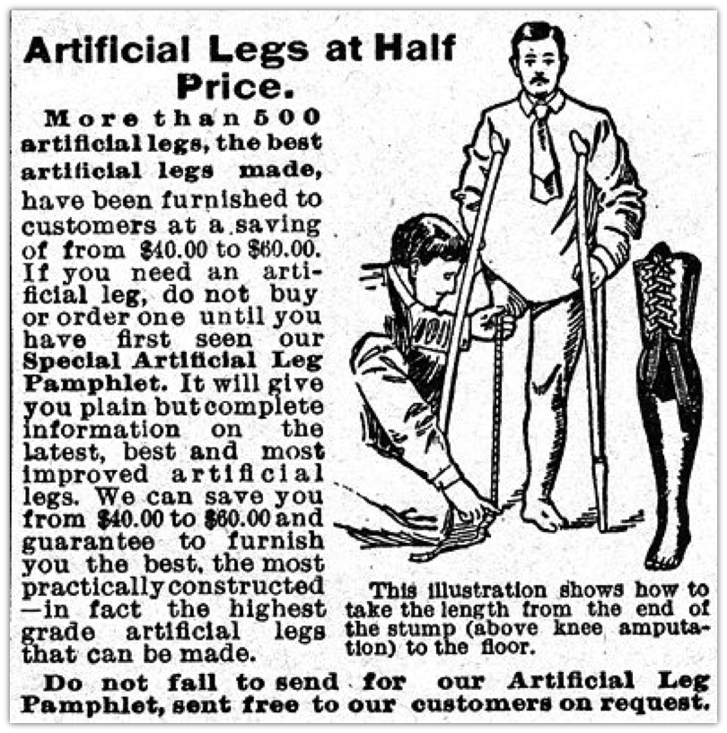

Development of a National Market
A new truly national market began to emerge as railroads, canals, the telegraph and telephone linked the country together.
National producers could ship their goods cheaper and would dominate sales in the West.
New methods of marketing and advertising gave manufacturers ability to expand across the nation.
Catalogs became “wish lists”
and when a new catalog came the old one served another purpose…

Slide 15


Impact of Population Growth
The USA experienced a rapid population growth, as the population jumped from over 2 million to 76 million in just 50 years, cities were crowded .
A high birth rate and a constant stream of immigrants created a rising demand for goods and the growing population was a steady supply of cheap labor.
This population growth favored business expansion.

Slide 16





Impact of Population Growth
Lumbering depleted the forests.
Sodbusters would plow the Great Plains to plant crops.
Mining for gold and other precious minerals destroyed the land.
The Railroads and buffalo hunters would soon wipe out the buffalo.
Rivers and lakes would be polluted.

Slide 17

Growth of Cities Brings Problems
Did you here Joe coughing all night?
Boy this water sure smells funny
Look out below !
The toilet doesn’t flush again !
Wish we could afford to move
Billy Bob you shouldn’t smoke in bed
If they don’t shut up I’m going to kick their &#@!
Something sure stinks

Slide 18

New Types of Business Organization
Before the Civil War, most businesses were owned by individuals or by a groups of partners.
After the war, corporations became more common.
A corporation is a company chartered by the state and recognized as a separate ‘person’.
Bam! BIG Business was born.

Slide 19

Corporations
Corporations issue and sell ‘stock’ or shares of a company.
A shareholder is a partial owner, and they receive a share of a corporations profits based on the amount of stock they own.
Shareholders were responsible only for the shares they own, not for losses and are protected from lawsuits.
Corporations allowed for people to pool their money to raise the huge sums needed to build railroads, factories, steel mill, etc.
Corporations made modern industrial production possible

Slide 20

The Free Enterprise System
The Success of America’s industrialization was based on its free enterprise system.
Free Enterprise System is when people have the freedom to make their own choices in what to buy, where to work, and what to make.
People are free to use their money and time to start a business in hopes of making a profit. (Producers)
People are free to choose the type of product they wish to buy and how much they’ll pay. (Consumers)

Slide 21
The Free Enterprise System
People have unlimited wants but we have limited resources to satisfy these wants.
Businesses use their resources to compete with each other to satisfy these consumer desires.
Every society must answer three basic economic questions to determine how to use its resources to satisfy these wants.
What Should Be Produced ?
How Should It Be Produced ?
Who Should Get It ?

Slide 22


Entrepreneurs
An Entrepreneur is a person that invests their time, money, and skills on the chance of making a profit.
In the 1870s these entrepreneurs dominated America’s economic life.
Efficient large-scale production allowed them to sell goods at lower prices and Competition forced them to continually improve the quality.
Many of these entrepreneurs made huge fortunes.

Slide 23





Captains of Industry
Many of the more successful entrepreneurs became known as ‘Captains of Industry’.
Some called them ‘robber barons’ because of the ruthless tactics they used to destroy their competition and methods used to keep workers wages low.
Some of the best known were:

Slide 24




The Gilded Age
The time when these Captains of Industry ruled America became known as the Gilded Age.
They amassed fabulous wealth and lavishly spent it while the majority of Americans were poor.
These ‘robber barons’ were glorified and vilified.
Some became the richest men in the world.

Slide 25






Political Cartoons on Robber Barons
Robber Barons were accused of
  unfair business practices,
  Being above the law,
  abusing labor with low wages and long hours,
  having too much, influence on government,
  Simply not caring about the American public,
  And being just plain greedy

Slide 26




Andrew Carnegie
Carnegie started penniless, but he made his fortune in steel mills in the Pittsburgh, PA area.
He undercut the competition, bought his own iron ore fields, coal mines and ships so he could control all phases of steel production.
He crushed attempts to form labor unions, paid low wages, and forced laborers to work 12 hour days.
The labor strike on Carnegie’s Homestead Steel Mill would be one of the eras most violent.

Slide 27


John D. Rockefeller
Rockefeller started out poor, but made his fortune in oil in Ohio.
Kerosene, for lighting, made him millions, later the gasoline industry, would make him even richer.
He used ruthless tactics to drive his competition out of business, then he would buy them out.
His Standard Oil Co. became a trust, with him owning most of the shares.
Later it would be a monopoly as he controlled 90% of all oil refined.

Slide 28


Philanthropy
Carnegie and Rockefeller both made millions at the expense of American pubic.
They paid low wages and demanded long hours of work.
As businessmen they didn’t believe in charity, their belief was;
‘help those who help themselves’
Later, both would lead the rich in philanthropy, they gave away millions of their dollars to the public.
They built libraries', museums, scholarships, and universities.
Here’s
a dime

Slide 29
Pros and Cons of Big Business
Large business is more efficient which leads to lower prices.
Hire large numbers of workers.
Produce goods in large quantities.
Have the resources for expensive research and to invent new items.
Unfair competitive advantage.
Often exploited workers.
Often unconcerned about pollution they may cause.
Have an unfair influence on government rules that affect them.

Slide 30
Laws Against Big Business
At first, the government did little to regulate big business.
Government and business leaders believed in laissez-faire
– the theory that government should not interfere in the operations of the free market.
Government did have some involvement in business, such as patent laws, enforcing contracts, laws protecting property, and tariffs to help American manufacturers.
Some of the anti-competitive practices of big business soon became so oblivious that reformers started calling for government intervention to remedy the problems.

Slide 31


Laws Against Anti-Competitive Practices
Interstate Commerce Act (1887)
Railroads often charged small farmers more to ship goods than large companies.
States passed laws to stop this, but the Supreme Court ruled these laws were unconstitutional.
Congress finally passed the Interstate Commerce Act that prohibited unfair practices by the railroads.
The Interstate Commerce Commission was created to enforce these laws.
First time Congress had regulated big business.

Slide 32

Laws Against Anti-Competitive Practices
Sherman Ant-Trust Act (1890)
Federal law aimed at stopping monopolies and trusts from engaging in unfair practices.
Attempted to prevent unfair competitive advantages.
Act marked a significant change in the attitude of government about the abuses of big business.
Standard Oil was the 1st monopoly the government attempted to stop.

Slide 33



The Conditions of Labor
As America continued on it astonishing economic growth there was increasing exploitation of industrial workers.
The average workday was long by today’s standards;
  10-14 hours a day
  6 days a week
  Wages ranged from $3 to $12 a week.
  Women and children were paid less.
  Conditions were dangerous.

Slide 34

Factory Working Conditions
As factory owners grew richer, the conditions for the new working class worsened dramatically.
Early factories were appalling, unsafe places to work with no safeguards for workers.
Jobs were repetitive, boring, and monotonous.

Slide 35









My name is Lil’ Cassie and I’m not a gansta
Hi, my name is Sally and I’m 8 years old
We work in a sweatshop for almost nothing
These are some images of what it was like to work in a factory
Factory Working Conditions

Slide 36

The Rise of Unions
As big business grew, workers lost all bargaining power with their employers.
Most work was unskilled and workers could easily be replaced.
Some worker began to form unions in order to act as a group, not as individuals.
Unions organized strikes and other forms of protest to get better working conditions.
Some owners refused to allow unions and would close a factory rather than negotiate with the unions.

Slide 37


Major Unions
Knights of Labor created a single national union by joining together skilled and unskilled workers.
They supported equal pay for women and opposed child labor.
They also opposed immigration, as they saw immigrants as competition for their jobs.
But, skilled workers resented being in the same union as unskilled labor and the Union soon fell apart.

Slide 38


Major Unions
American Federation of Labor founded by Samuel Gompers hoped to create a union that united workers with similar economic interests.
The AFL consisted of separate unions made up of skilled labor.
Gompers wanted a closed shop, where workers had to join the union in order to work.
But the AFL failed because it excluded non-skilled workers.

Slide 39

Government Attitude Towards Unions
Government leaders were critical towards unions, they favored business over labor.
More than 20,000 strikes occurred between 1880 and 1900, some were violent.
Government officials feared union strikes would have a negative impact on the USA’s economy.

Slide 40



Union Strikes and the Public
Public opinion also favored the idea of laissez-faire policies, of little government involvement.
Most believed that businesses had the right to hire and fire whoever they wanted.
They feared unions would lead to higher prices.
The Haymarket Affair of 1886 emphasized the violence that had become associated with union strikes.
Other infamous strikes included:
  Pullman Strike
  Homestead Steel Strike

Slide 41
Free Enterprise System
Individuals are free to produce and sell whatever they chose to.
People go into business to make a profit.
Prices are set by supply and demand.
Inefficient companies that are unable to compete are driven out of business.
Government has a limited involvement in :
  protection of property and contracts,
  passing protective tariffs,
  establishing a system of patents.

Slide 42
Growth of America’s Industry
The Transcontinental Railroad and other railways improved travel and trade.
The USA’s population exploded.
Development of a national market.
Technological Progress:
  Bessemer Process in steel production
  Electricity opened new industries
  Oil industry boomed
  Development of corporations to raise money and limit liability

Slide 43
Entrepreneurs
“Robber Barons” or “Captains of Industry”?
Robber barons used ruthless tactics to destroy competition and keep workers wages low.
Andrew Carnegie –
  Dominated steel industry by owning iron ore fields, coal mines, and steel mills.
  Became a philanthropist, gave away millions.
John D. Rockefeller –
  Monopolized oil industry until Sherman Act.

Slide 44
Organized Labor
Problems of Workers:
  Long hours, low pay, dangerous conditions.
  Child labor and unequal pay for women.
  Lack of job security.
Rise of Labor Unions:
  Knights of Labor - Terrence Powderly
  American Federation of Labor - Samuel Gompers.
Government attitude towards unions:
  Anti-union bias, unions drove up cost of goods.
  Violence associated with strikes, like Haymarket Riot brought negative attention to unions.

